Slide 1


World Development Appeal 2022

Slide 2
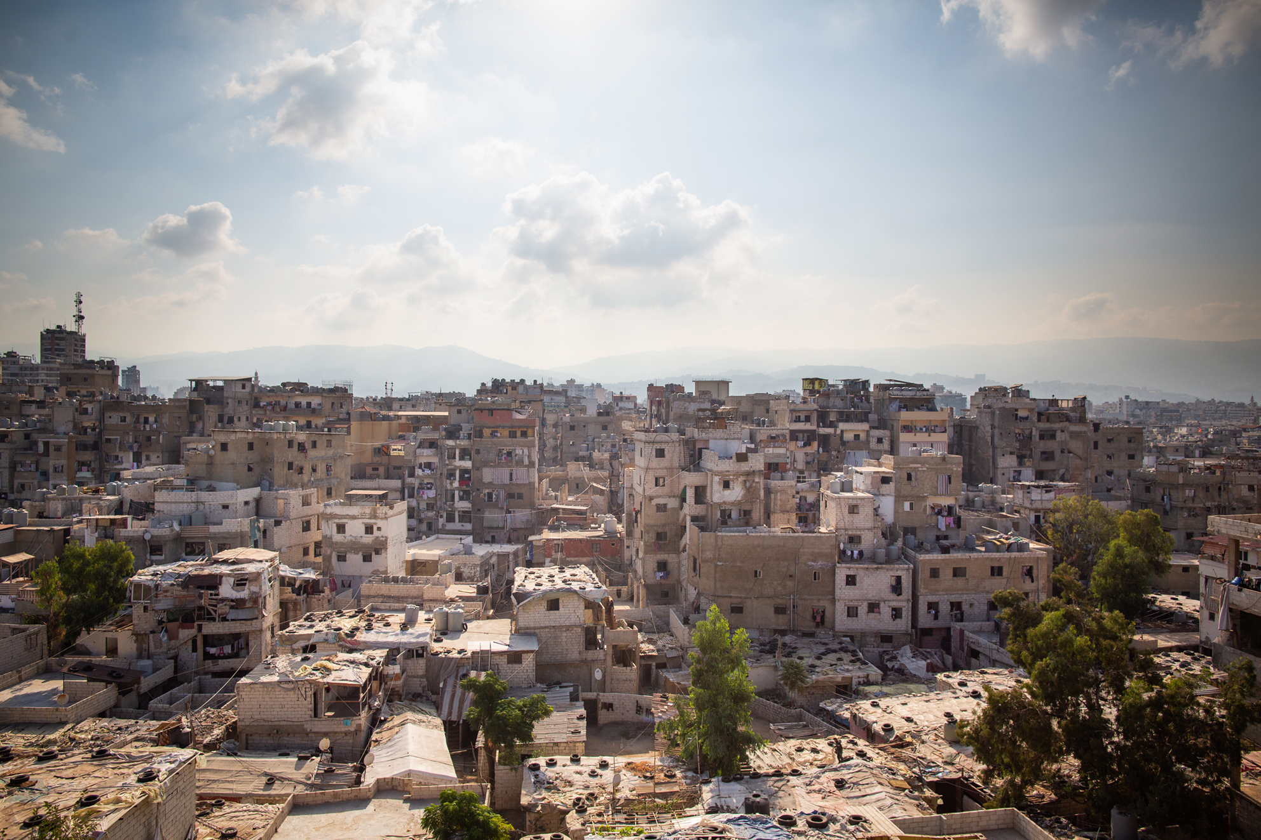


Slide 3
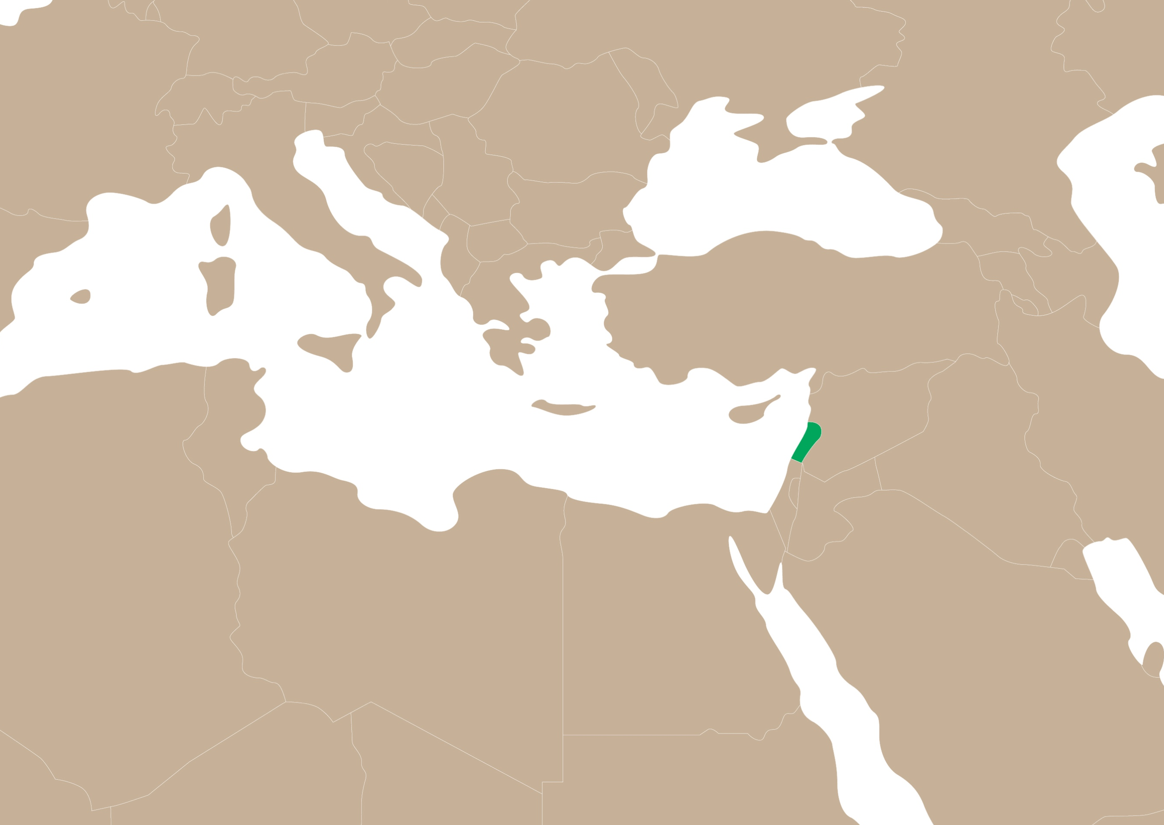

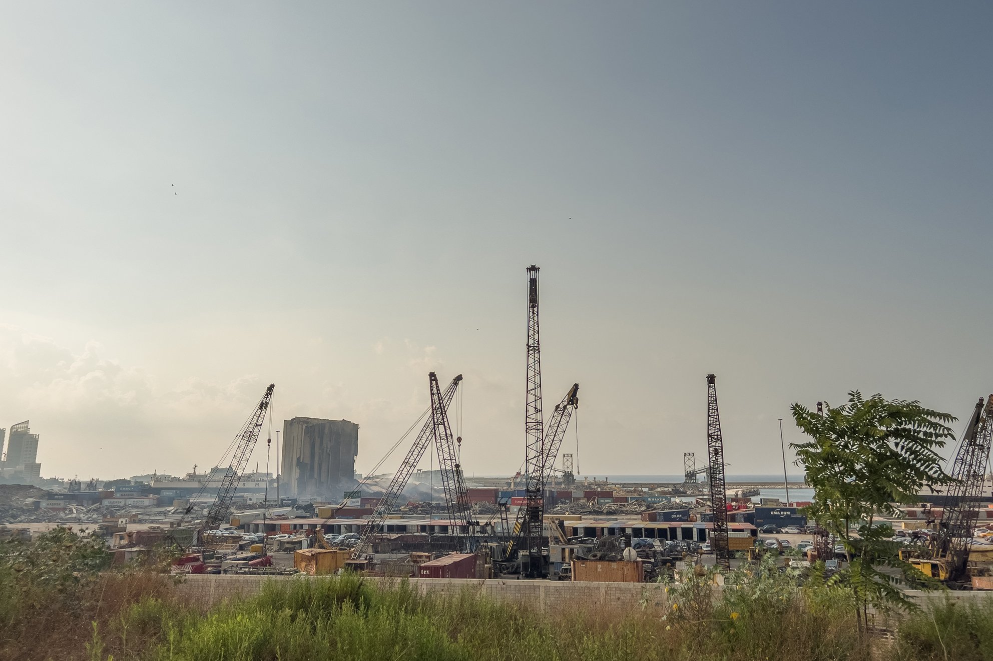
Lebanon

Slide 4
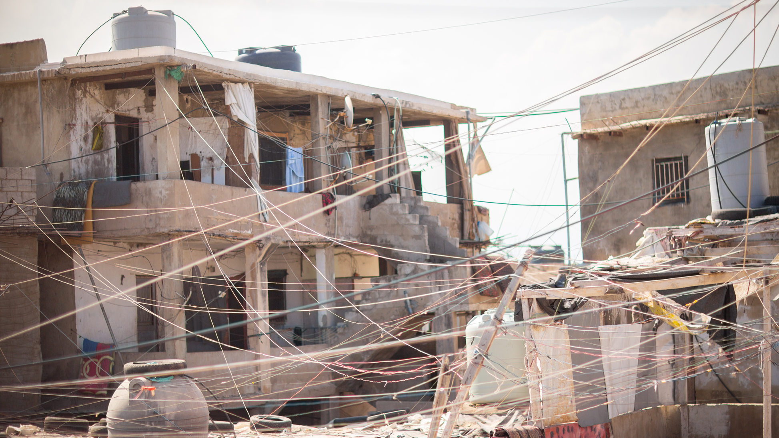

Slide 5
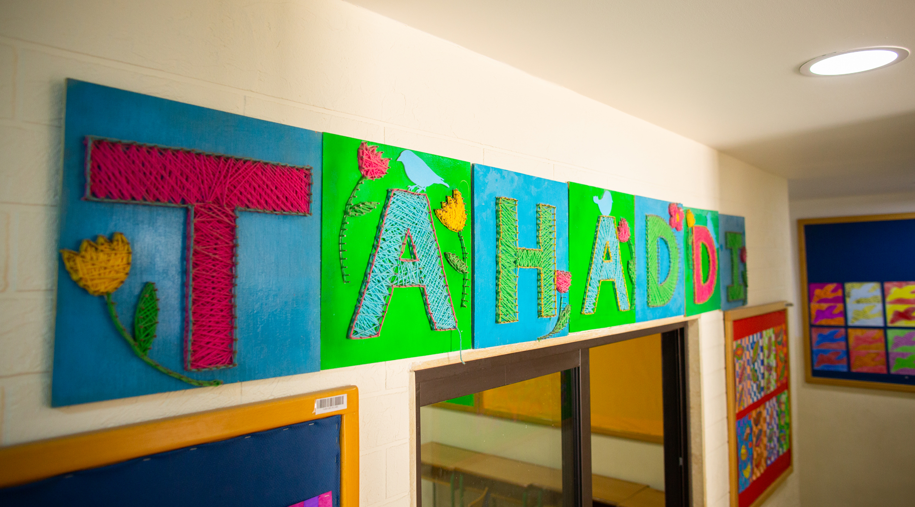

Slide 6


Slide 7
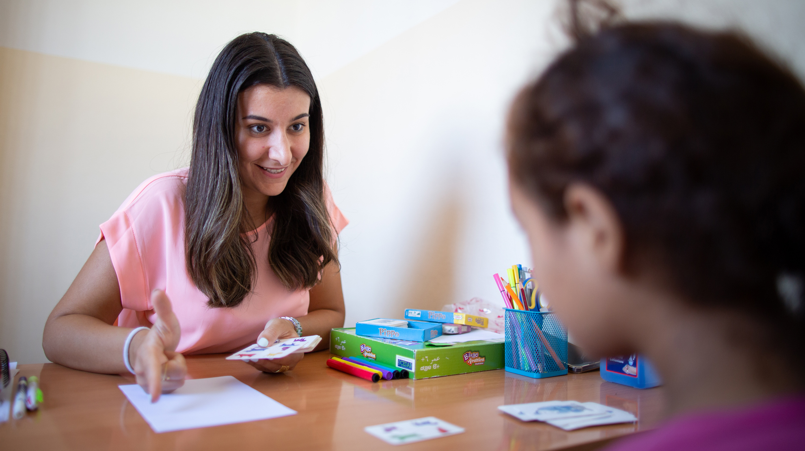

Slide 8
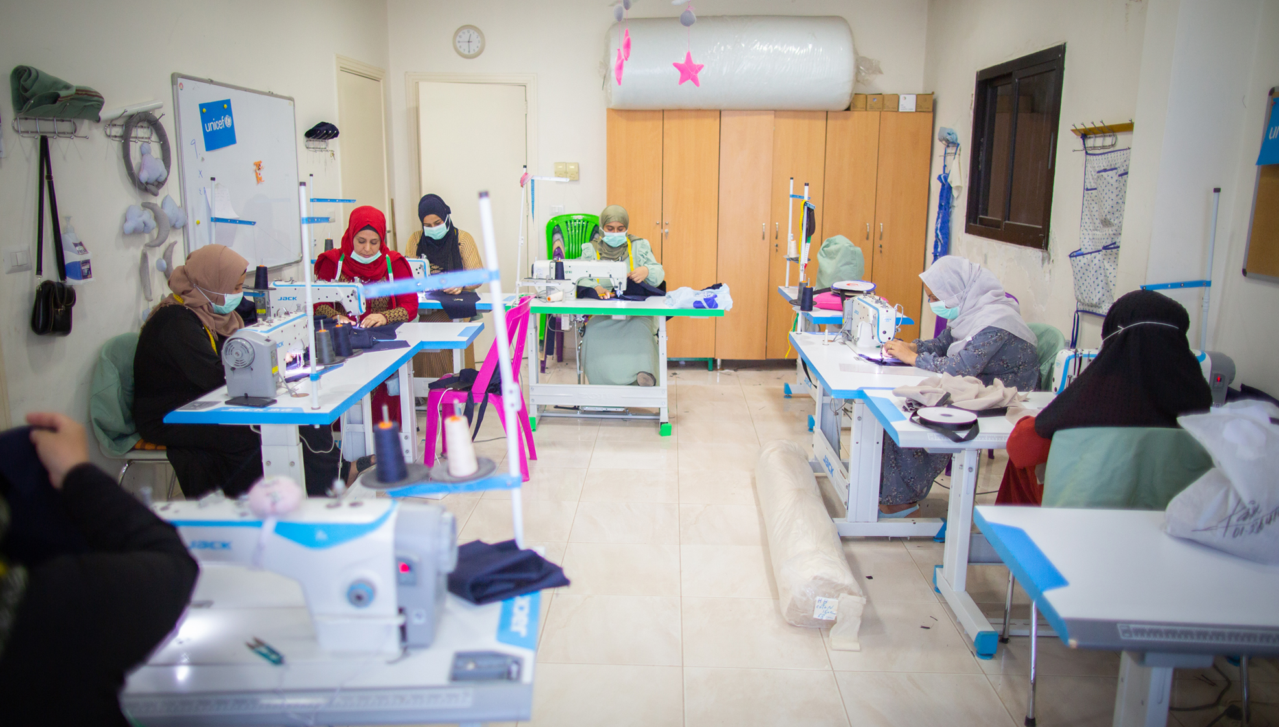

Slide 9
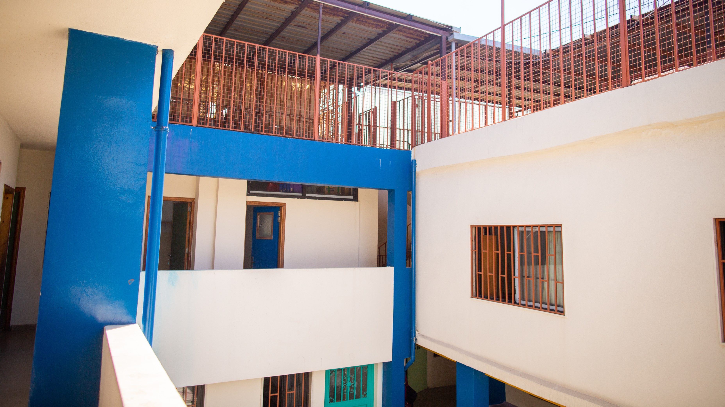

Slide 10
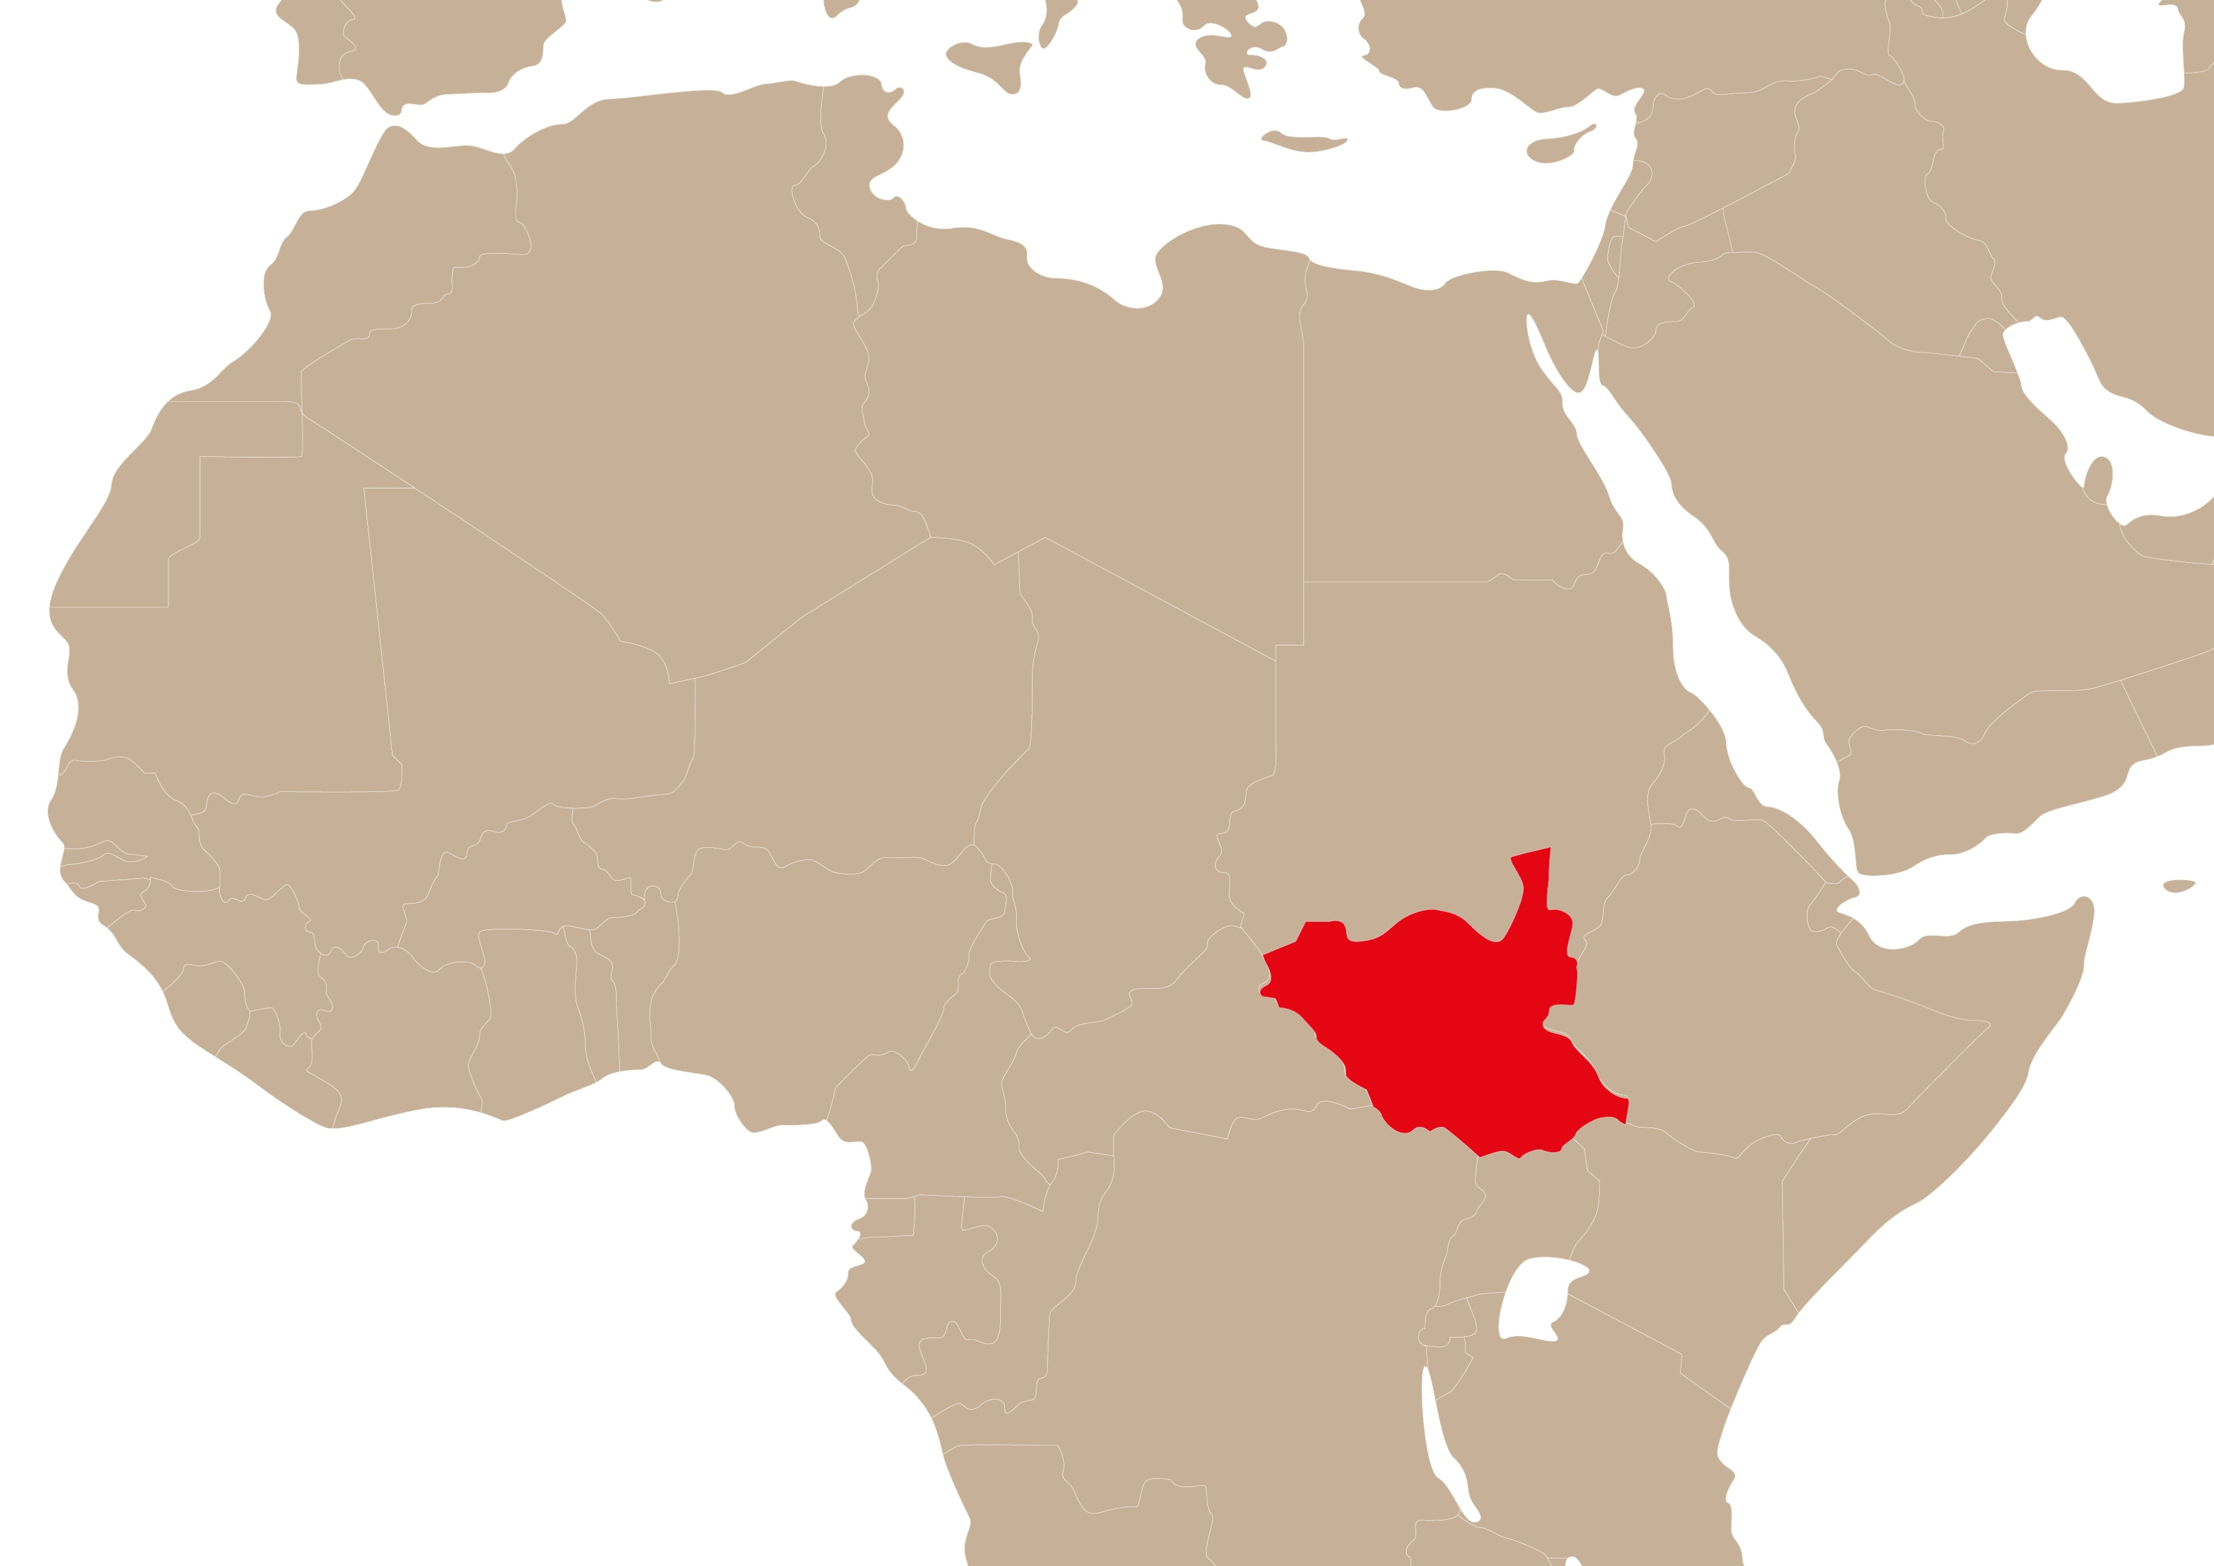


South Sudan

Slide 12
Points for prayer
Pray for people worldwide who have been forced to flee from their homes
Pray for the communities that are welcoming these people and those who are dedicated to being the light in the darkness
Pray for Lebanon, a country in economic and political turmoil, and the work of organisations like LSESD
Pray for South Sudan and the peacebuilding efforts by organisations like the South Sudan Council of Churches

Slide 13
www.presbyterianireland.org/worlddevelopment

