Slide 1

World Development Appeal 2023

Slide 2
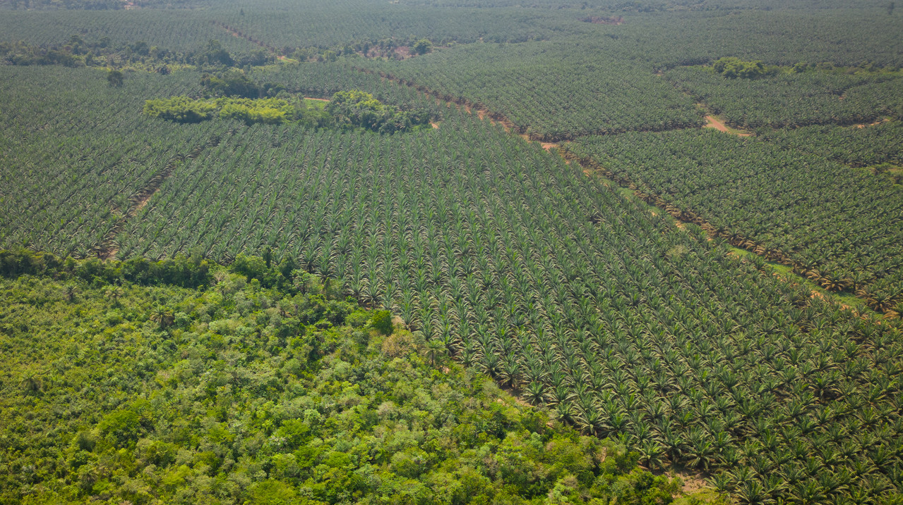
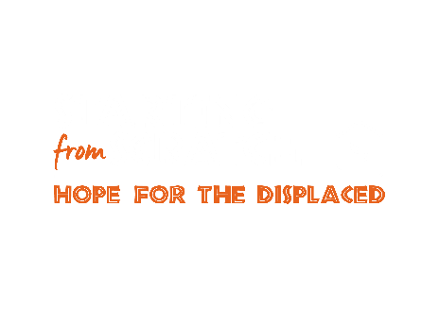

Slide 3
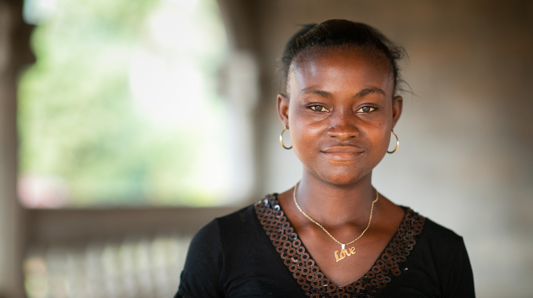

Slide 4
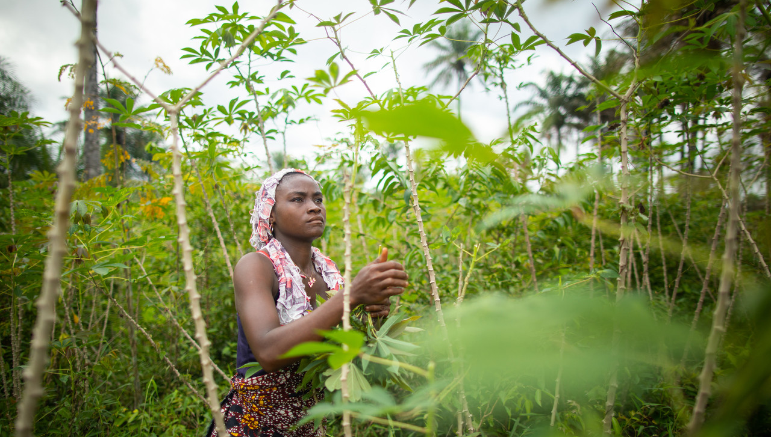

Slide 5
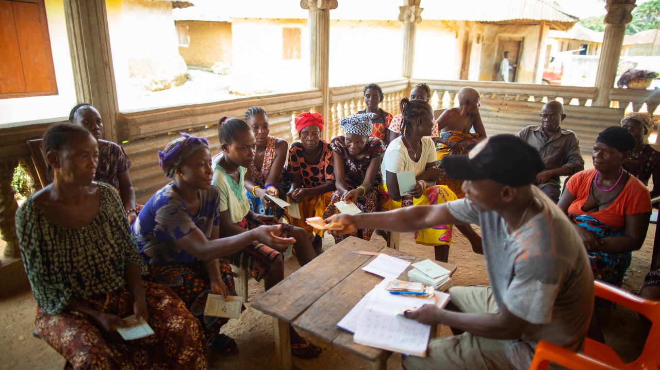


Slide 6
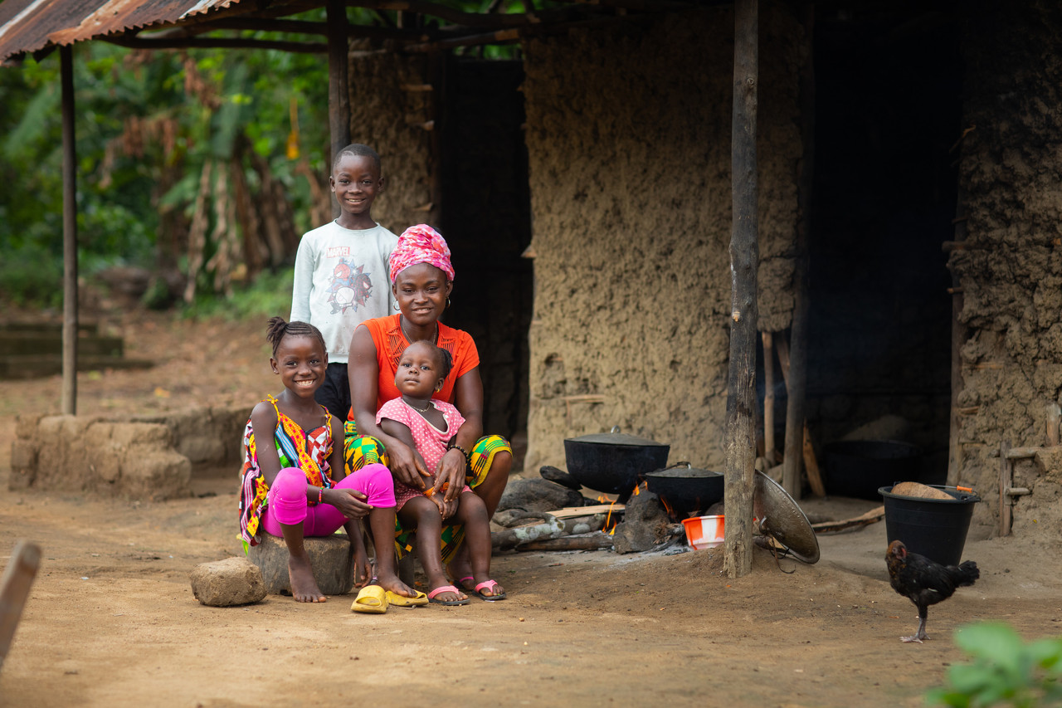

Slide 7
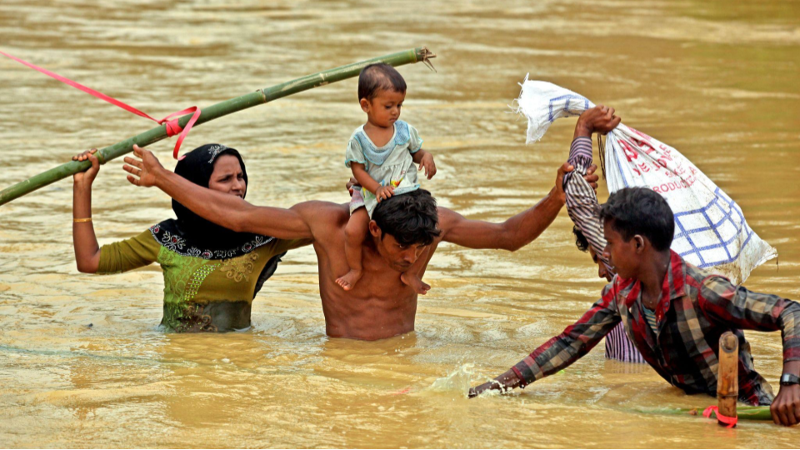


Slide 8
Points for prayer
Pray for justice for those living under the shadow of injustice
Pray for the people who have had to start from scratch after being displaced from their homes
Pray for the organisations who are bringing hope by helping people rebuild their lives

Slide 9

www.presbyterianireland.org/worlddevelopment

