Slide 1
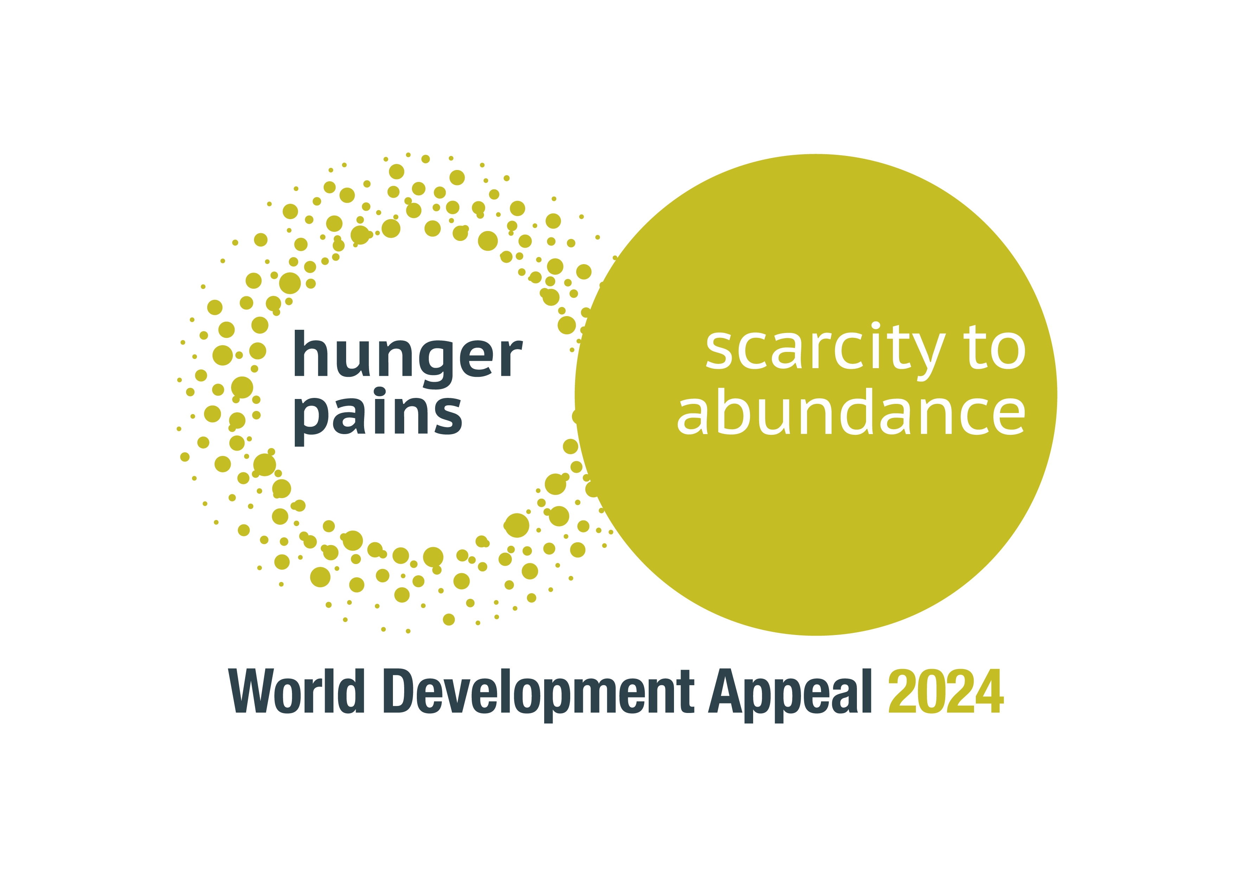
Notes:
SLIDE 1 – LOGO
The annual World Development Appeal of the Presbyterian Church in Ireland offers congregations the opportunity to learn more about, and to support work undertaken by our development partners, Christian Aid and Tearfund. Proceeds from the appeal are divided equally between these two partners to support a variety of development projects around the world. However, each year the appeal also focuses attention on one particular project. This gives congregations the opportunity to ‘go deep’ in understanding some of the challenges of sustainable development in a particular location, while also being able to ‘go wide’ in contributing to projects in several parts of the world.
The 2024 World Development Appeal
Around the world, millions of people continue to face the serious challenges of hunger and malnutrition. Both Tearfund and Christian Aid are seeking to help families and communities find productive ways to work towards growing and sharing their own food.

Slide 2
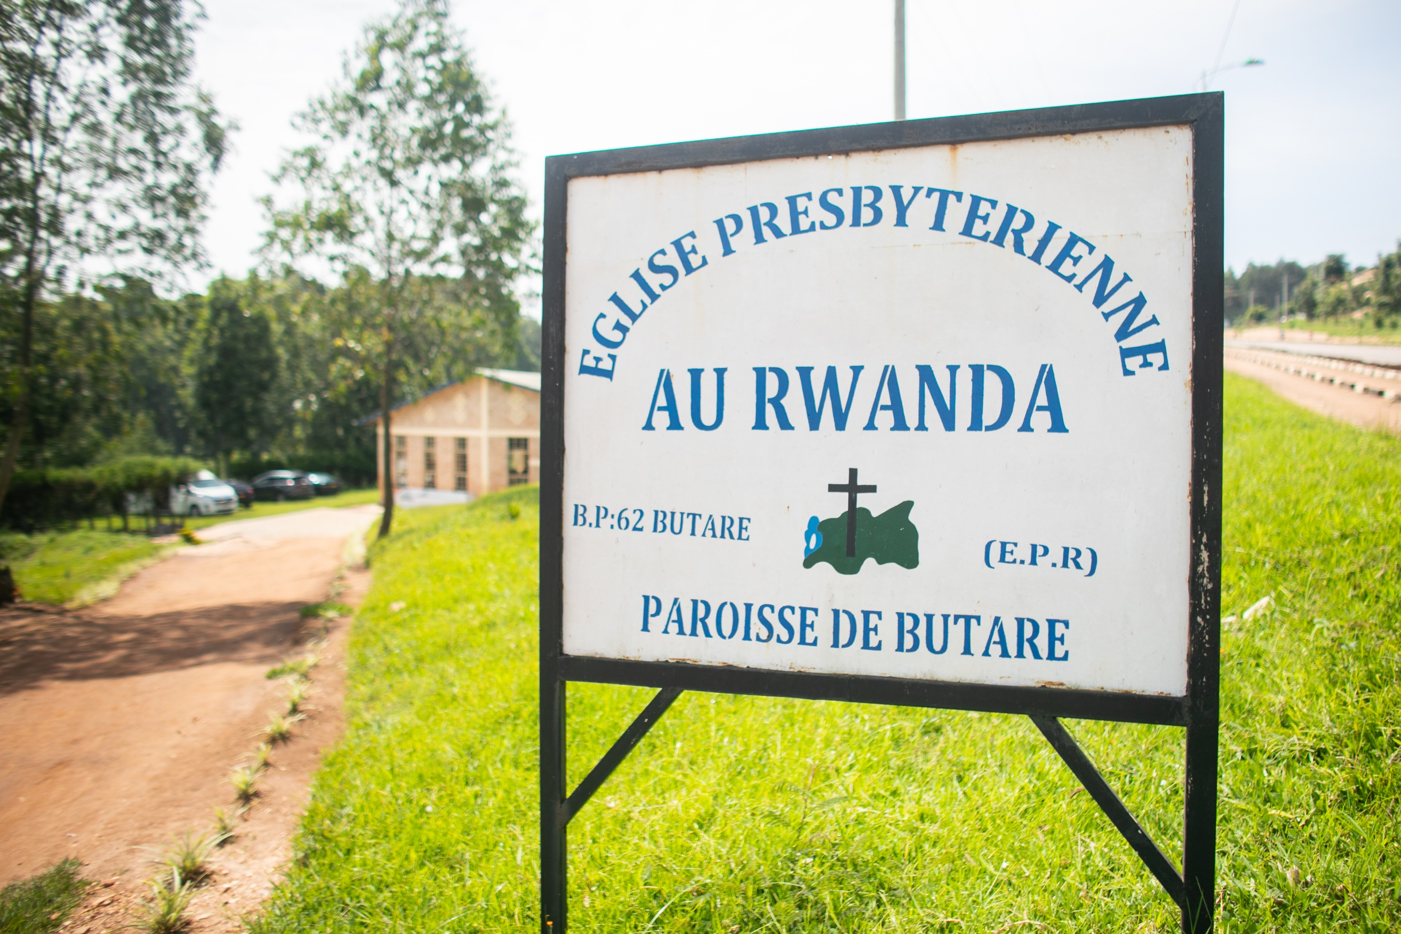


Notes:
SLIDE 2 – INTRODUCTION TO COMMUNITY AND CONTEXT
This year we focus on a Tearfund project in Rwanda. In their Church and Community Transformation (CCT) programmes, local facilitators are trained to help identify and respond to needs. One example is the Butare parish of the Presbyterian Church in Rwanda which ‘identified many issues, including malnutrition and homelessness.’

Slide 3
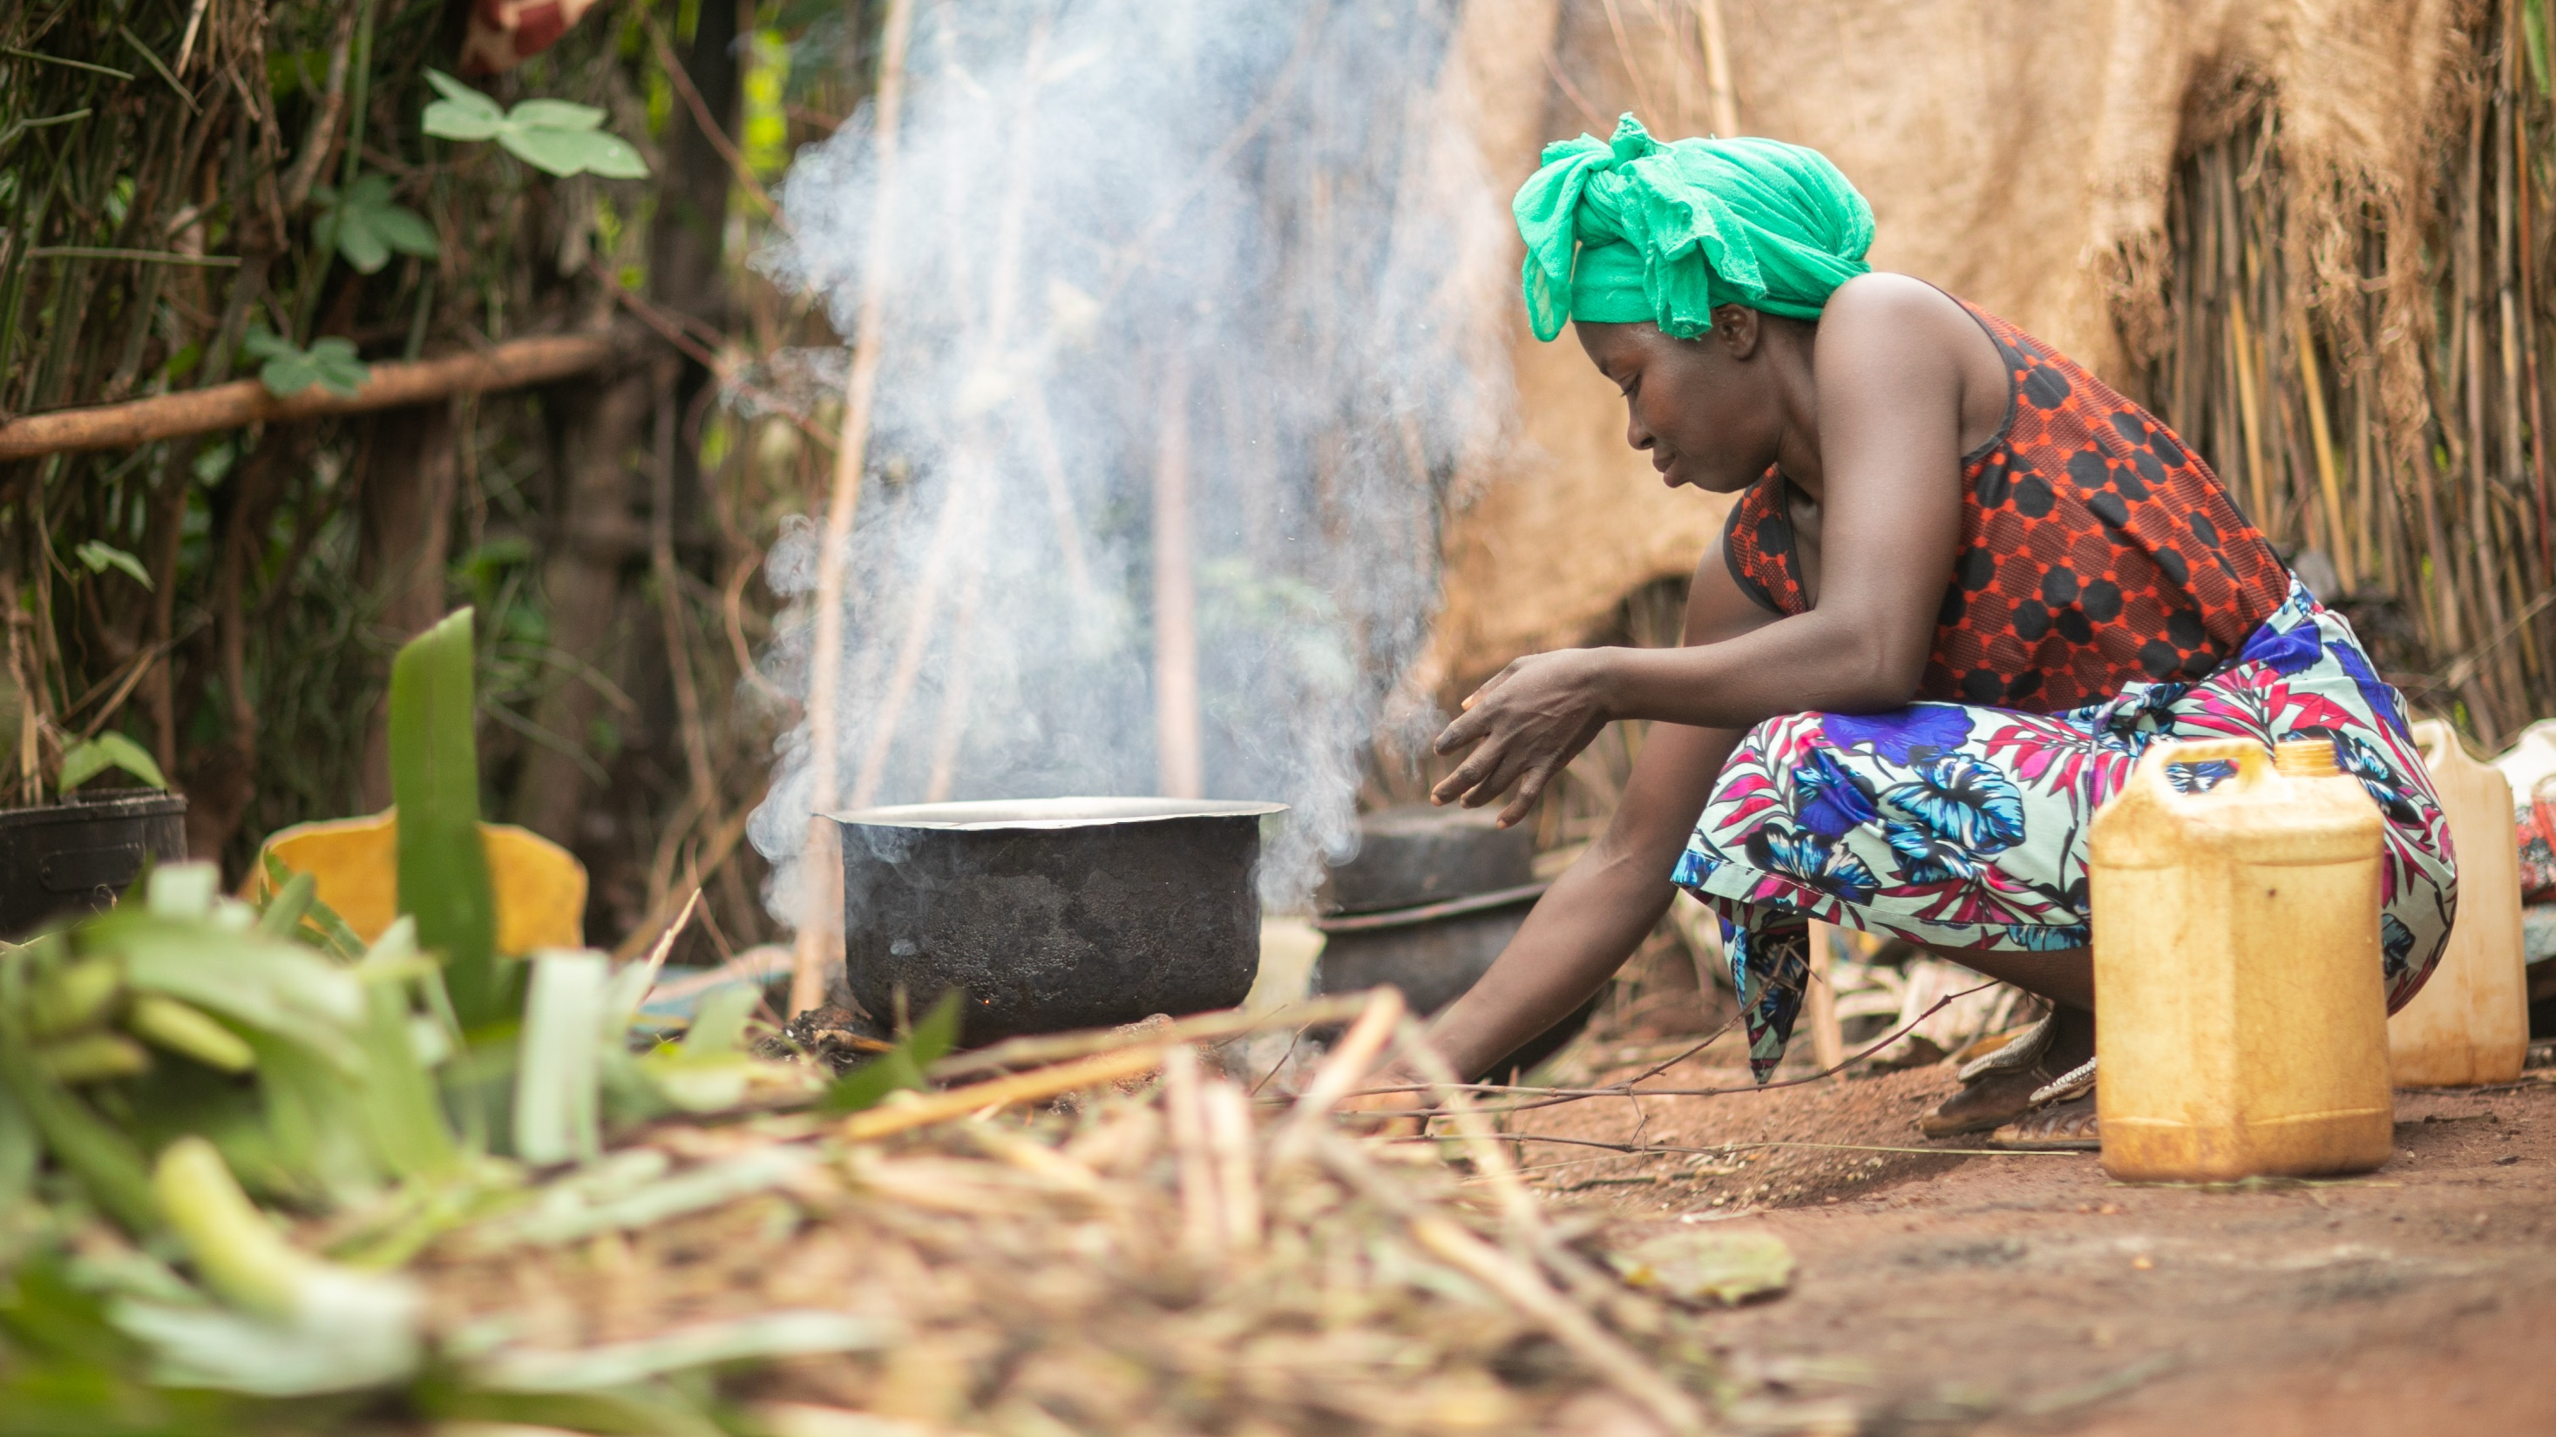
Notes:
SLIDE 3 – DELPHINE
One of those affected was Delphine, a mother of four children. She tells her story: ‘I grew up in a very poor family who abandoned me, making me homeless. My second child was born blind. As someone who had nowhere to live, giving birth to a blind child was very difficult.’

Slide 4
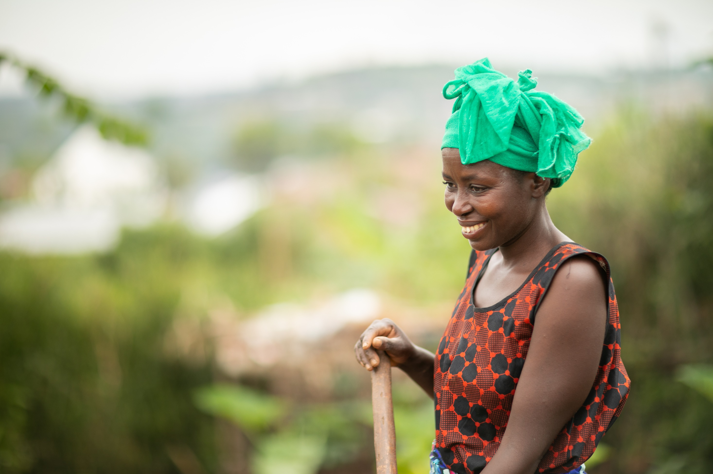
Notes:
SLIDE 4 – NEW OPPORTUNITIES
She met the local facilitator, Serapie, who invited her to the prayer group and training. Delphine describes the impact: ‘After the CCT training my mindset was totally changed. I received training on how to grow crops that would support my children. Before, my children were malnourished. I now grow my own vegetables mixing them together for a balanced diet.’

Slide 5
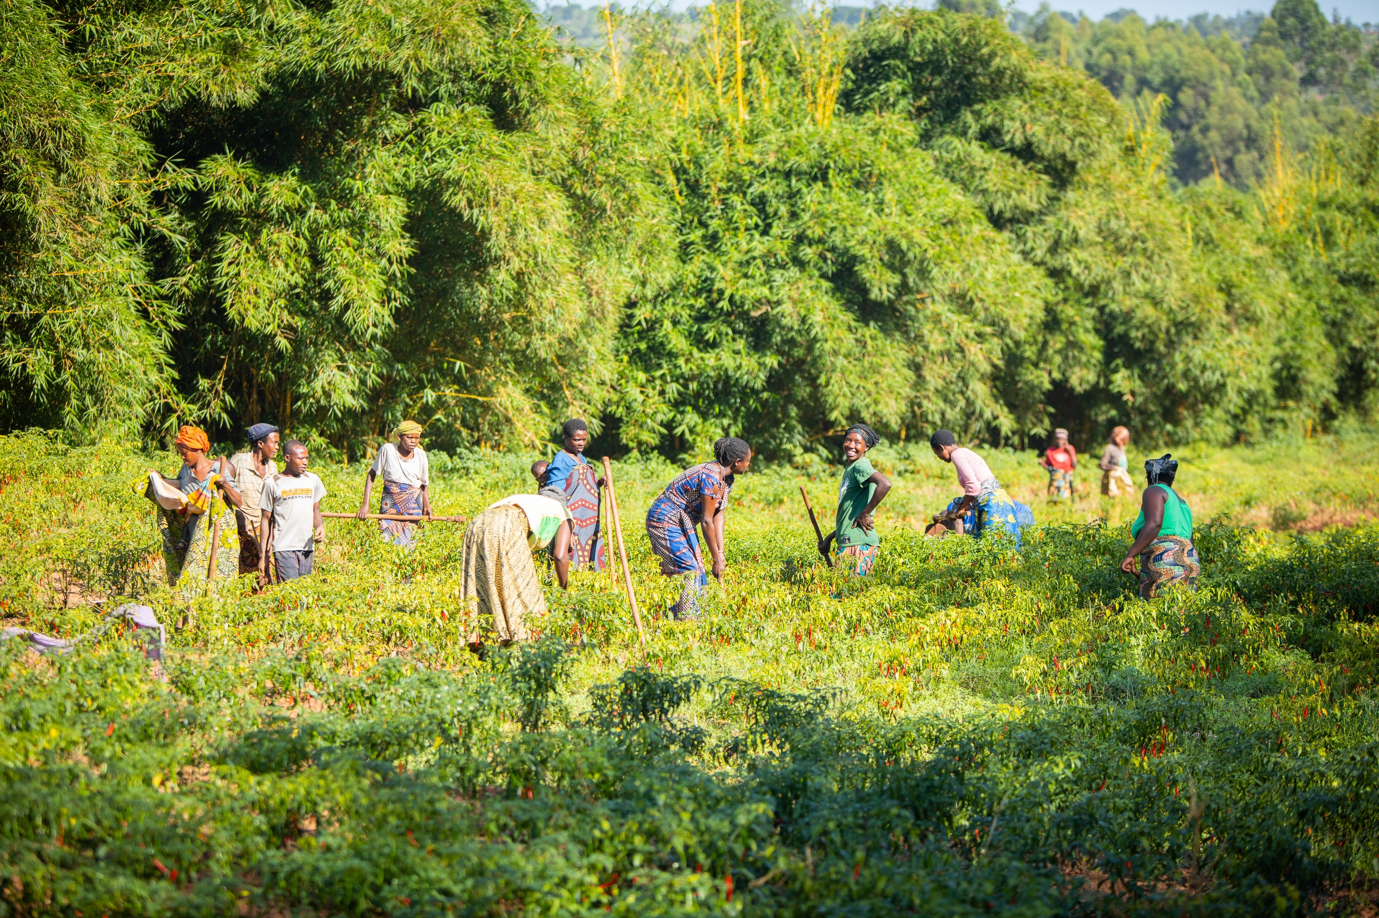
Notes:
SLIDE 5 – SELF-HELP GROUPS
In this church fifty people were organised into five self-help groups. Serapie explains that they were able to acquire a piece of marshland to cultivate, with ‘multiple growing seasons for maize and other vegetables.’

Slide 6
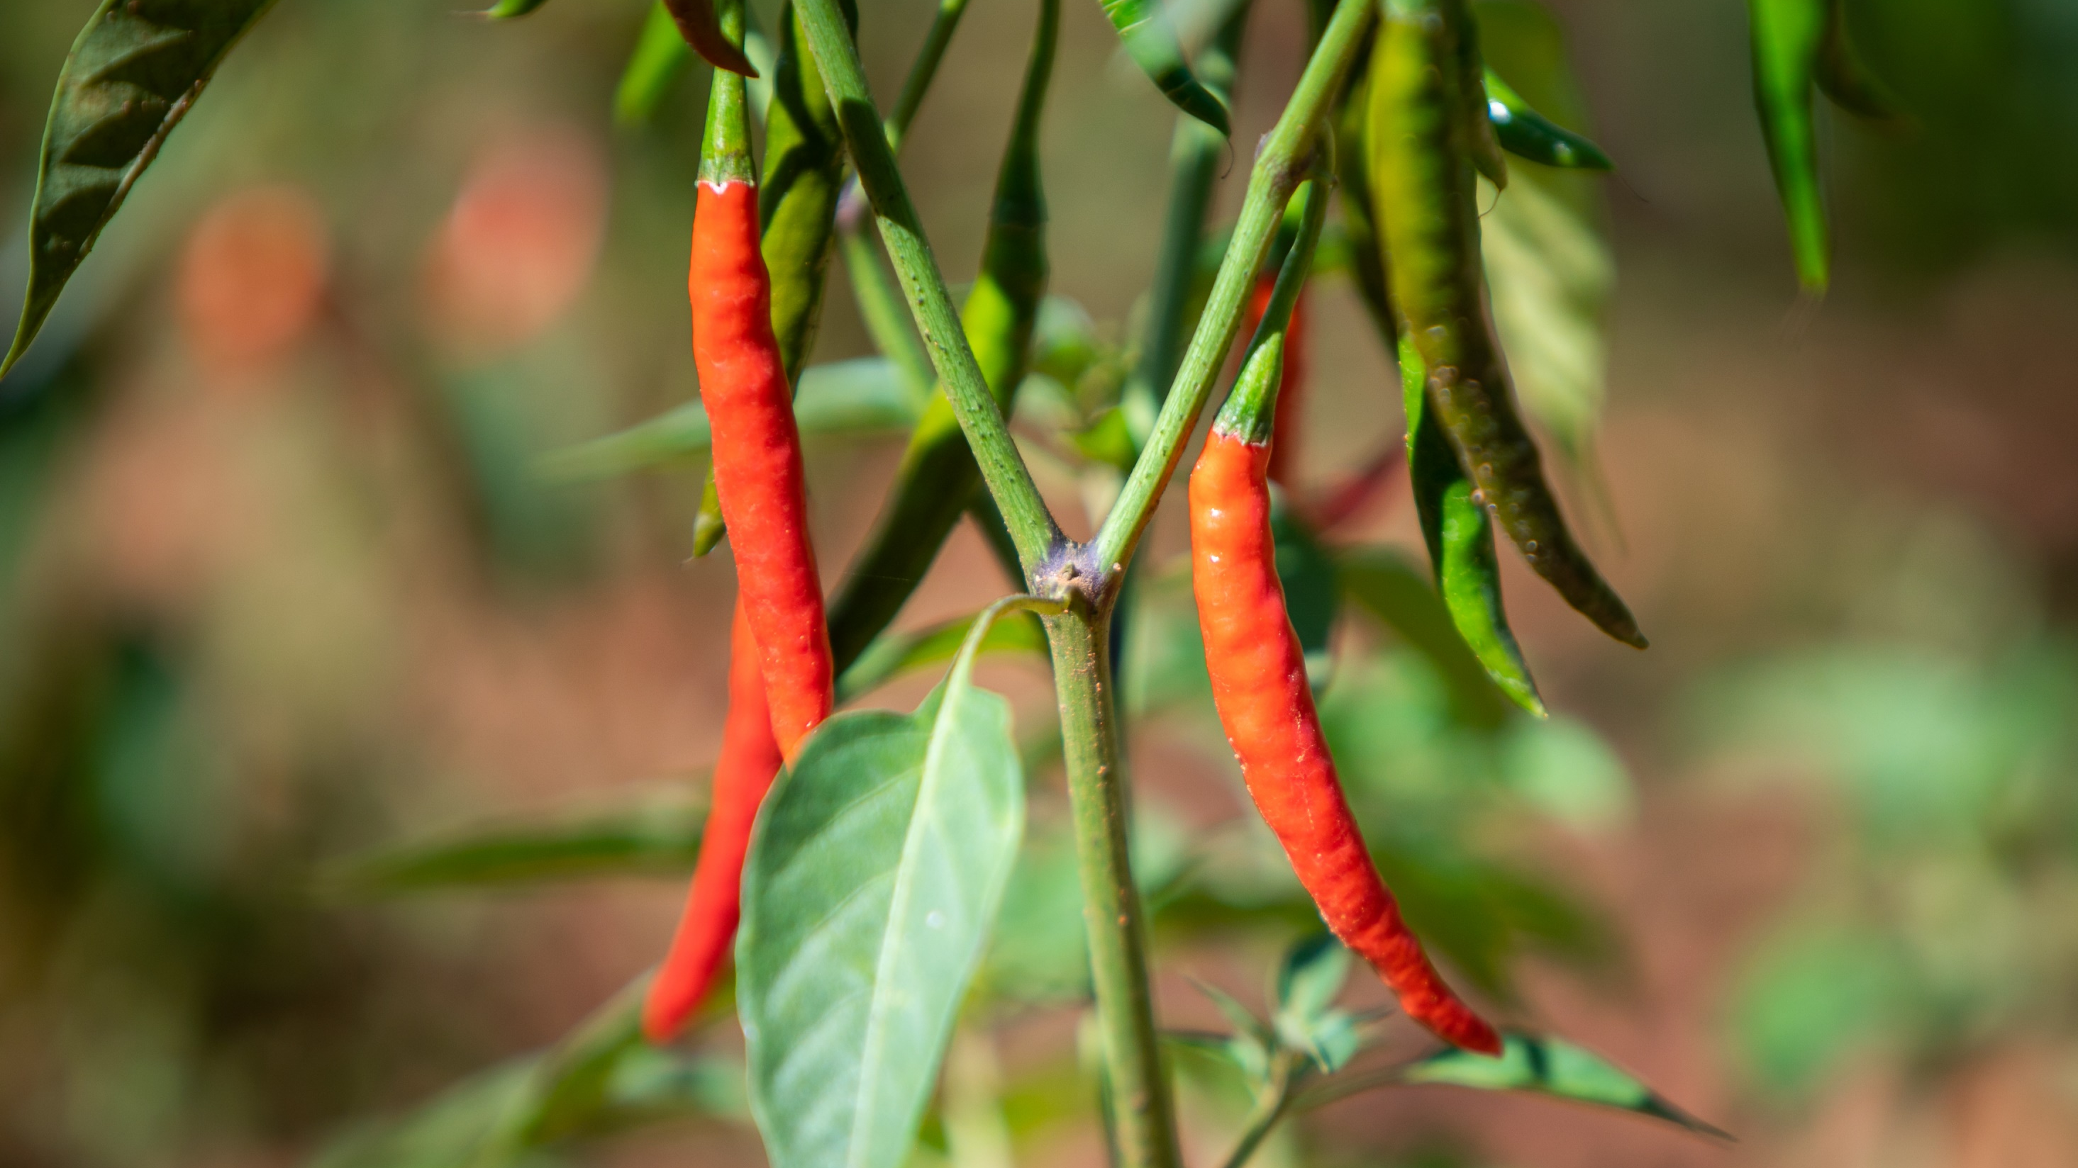
Notes:
SLIDE 6 – SAVINGS AND LOANS
In addition to growing their own food, Serapie describes how ‘by working together, they were able to sell their surplus to generate income.’ They have grown pepper – ‘a crop that they can easily sell at the market.’ The community also established a self-help lending group. Delphine tells how she requested a loan from this savings group: ‘I was able to buy construction materials and with the help of the community I was able to build my house and am no longer moving around with my children … I was once a vulnerable person in this community but now I can support other people while sharing the word of God with them.’

Slide 7
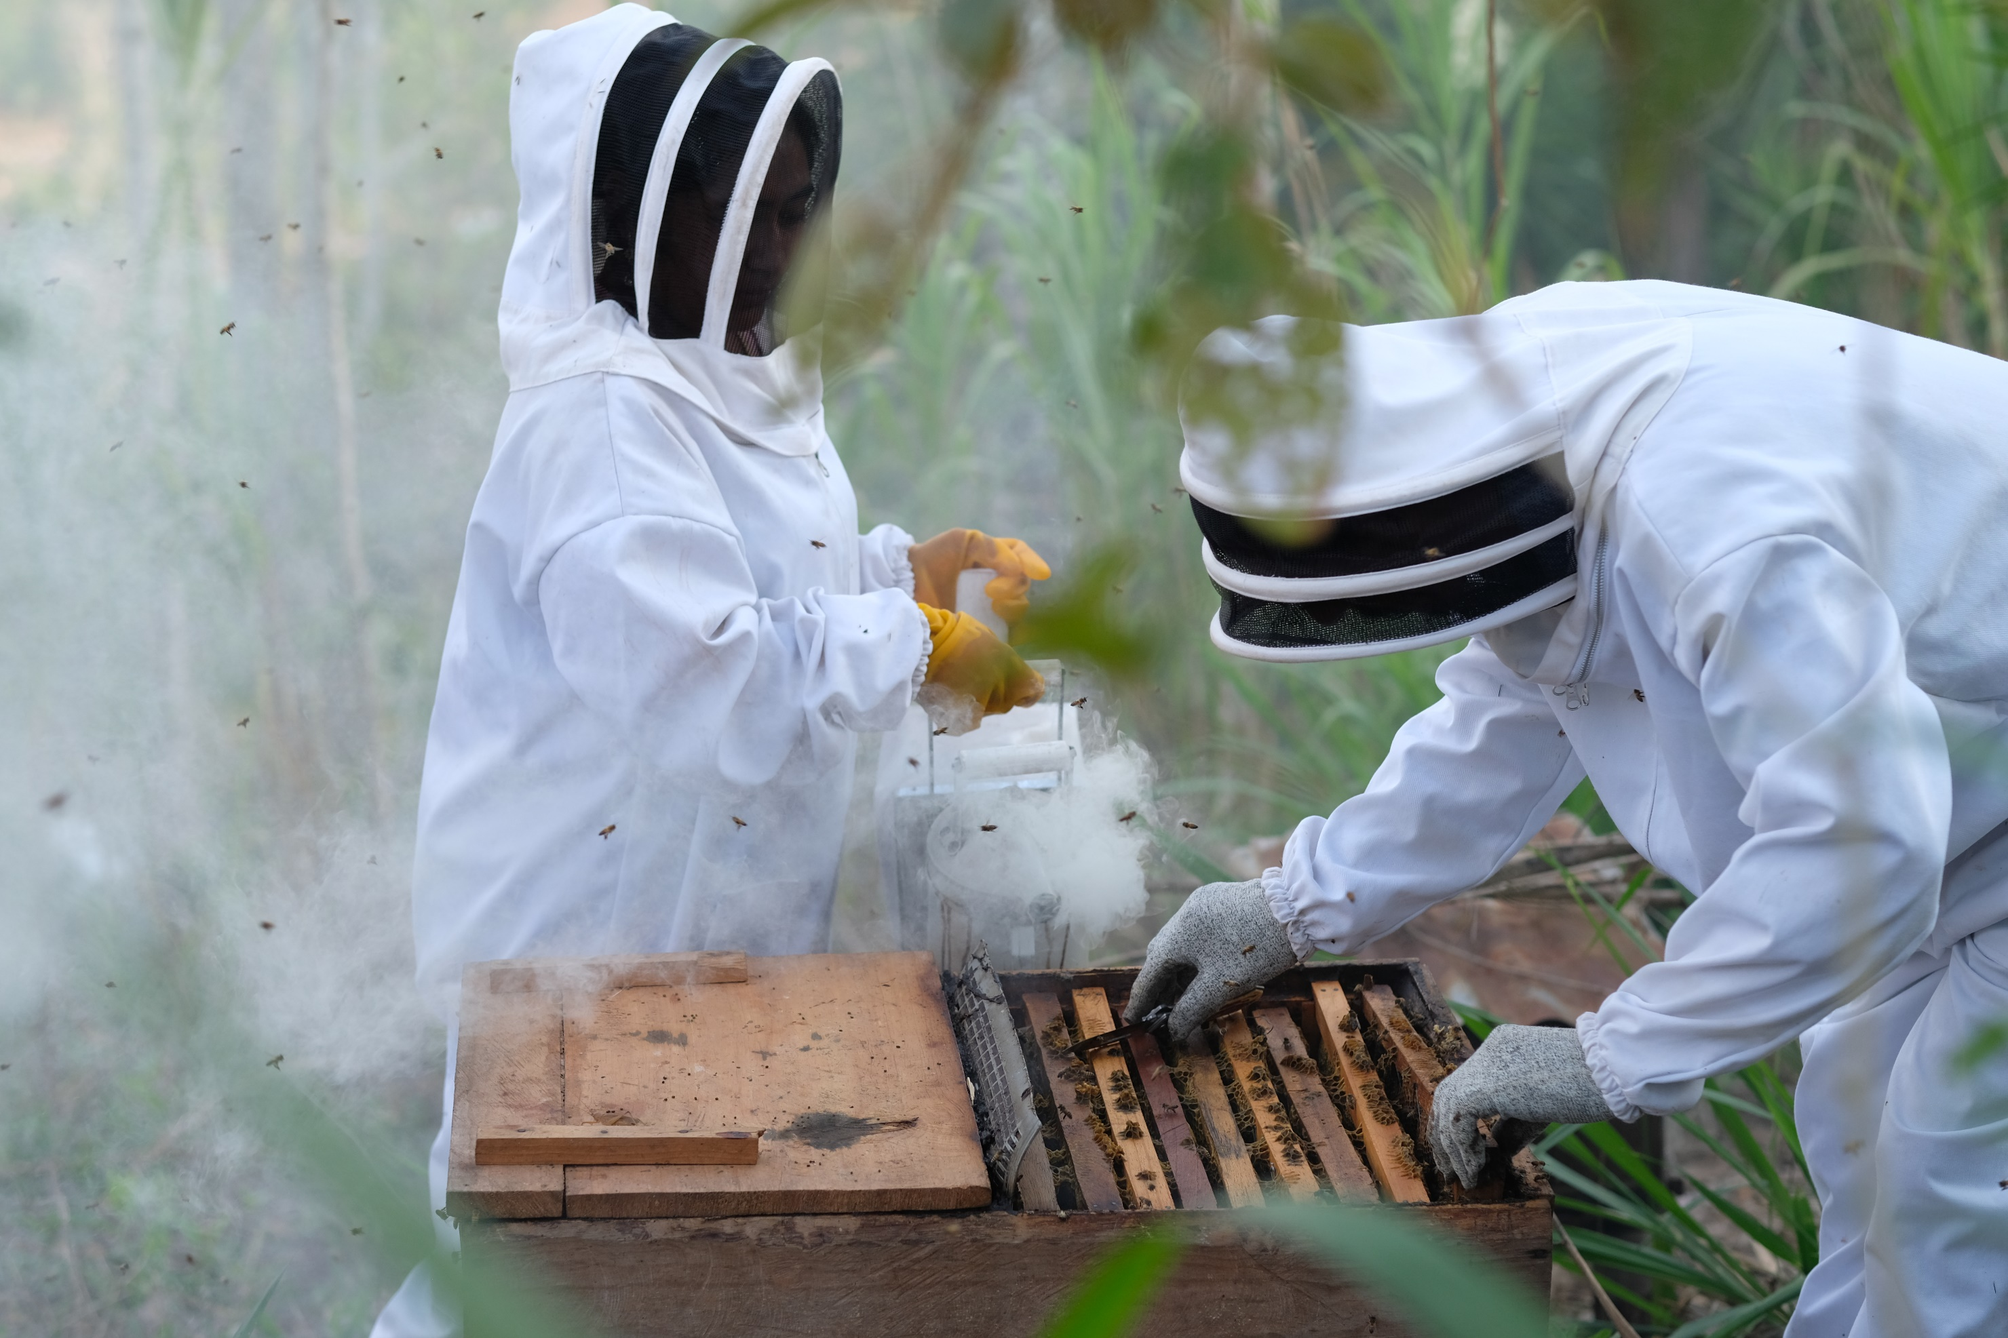
Credit: Amy Sheppey/Christian Aid
Notes:
SLIDE 7 – PROJECT IN HONDURAS
This year’s Appeal will also support Christian Aid projects, including in Honduras – ‘supporting families like Julio and Carmela’s to stay together, helping them establish sustainable, climate resilient income generating activities such as beekeeping and fishing. Julio and Carmela are thankful to God, well-nourished and hopeful for the future of their four children.’
Credit: Amy Sheppey/Christian Aid
Caption: Farmers living in the 'dry corridor' of Western Honduras, face multiple emergencies; food insecurity, the climate crisis, violence from drug corridors, environmental destruction, and economic migration. Christian Aid partners, are working with farmers like Julio and Carmela to diversify their livelihoods and adapt their farming practices.
Julio and Carmela (photographed) believe their strong faith, and commitment to beekeeping will preserve their environment and prevent their children from going without.

Slide 8
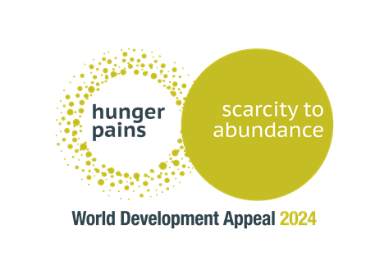
POINTS FOR PRAYER
Pray for Christians around the world loving
and caring for hungry people in their communities.
Pray for strength and endurance for people working on the land in difficult circumstances.
Pray for good harvests of crops and sharing produce.
Pray for the Church in Rwanda to have everything needed to share with others.
Notes:
SLIDE 8 – PRAYER POINTS
Pray for the World Development Appeal and projects around the world that it seeks to support.

Slide 9
Thank you!
www.presbyterianireland.org/world-development
Notes:
SLIDE 9 – THANK YOU
Thank you for your support of this year’s World Development Appeal.

